Slide 1
Good Games

Slide 2
Introductions
Michael Voorhies
Casey Adams
Anthony Ganster
Dominic Perrine

Slide 3
What we did
Anthony Utilized Azure Storage to store images used on the site.
Dominic Improvements to the cart and store checkout functionality.
Michael Created roles for users to restrict various areas of the site.
Casey Built transaction records and implemented form validation.

Slide 4
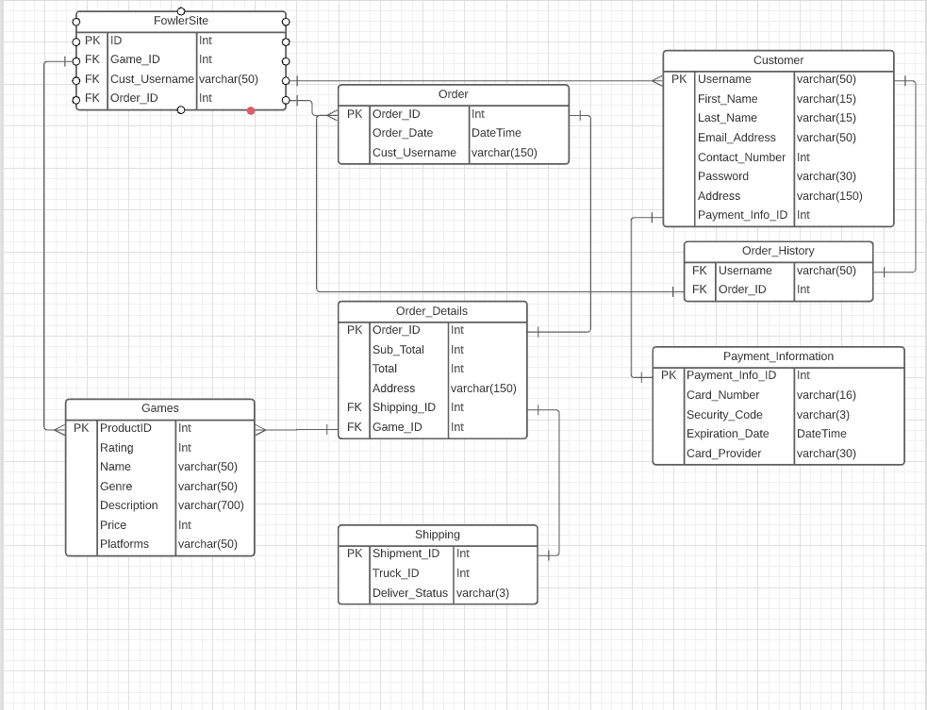
ERD

Slide 5


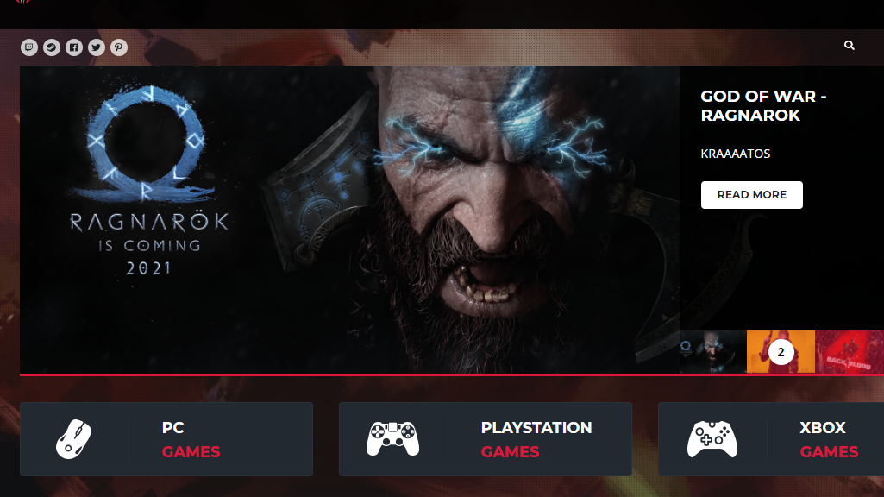



LIVE DEMO

Slide 6

Questions

